Slide 1
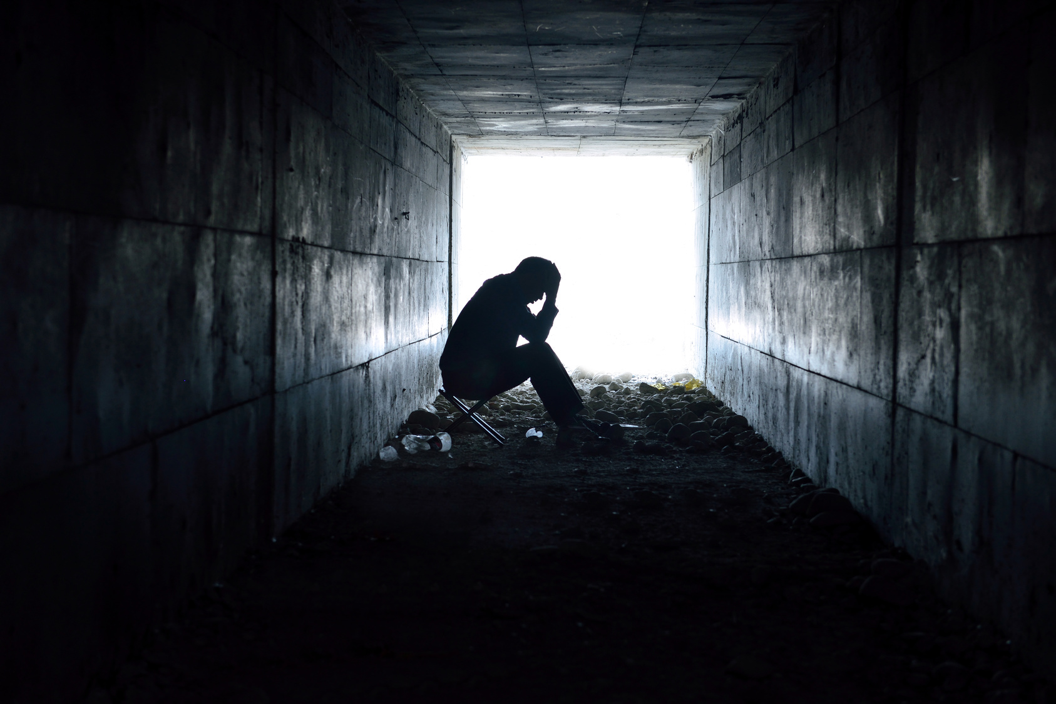
BBM421 GAME TECHNOLOGIES PROJECT
AGATEOPHOBIA
Ali Sahin Balikci
Gokay Atay
Sena Berre Ceylan

Slide 2
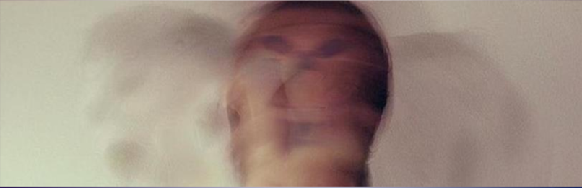
DESCRIPTION of the Game / RemInder
Agateophobia is a single player horror game. It can be defined under tags as horror, adventure, puzzle, mystery, choices/actions matters and story rich. It consists of three levels that individually designed and each level has different puzzle/puzzles. These puzzles will affect the ending of the game. Also player's choices and actions may change the game progress and gameplay.

Slide 3
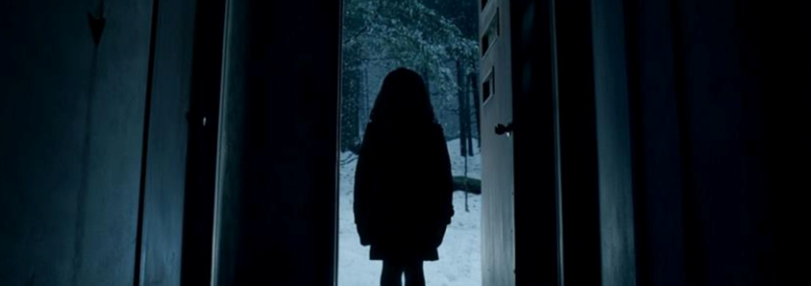
Agateophobia's main story consists of a paranoid man, his past, present thoughts and dreams. Like his daughter's death, bad things he's been through combined with his phobia makes him insane. He starts to see the reality different, depending on his subconscious. He blames himself about his daughter’s death (burnt in their house), and through the game he is hallucinating about his daughter, places that he’s been through and so on.

Slide 4
Agateophobia can be played in first person view, player experiences the action through the eyes of the protagonist and can control the character via keyboard/mouse. Environment changes in each level and player can interact with some objects in the scenes. There will be some cinematics occurred in the gameplay and there are some horror stuff like sound effects and jump-scares.

Slide 5
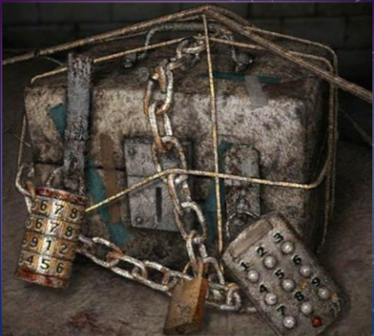
Player is forced to discover the environment in an undirected way. Puzzles must be solved for the game progress, also these puzzles and timing is important for the ending.

Slide 6
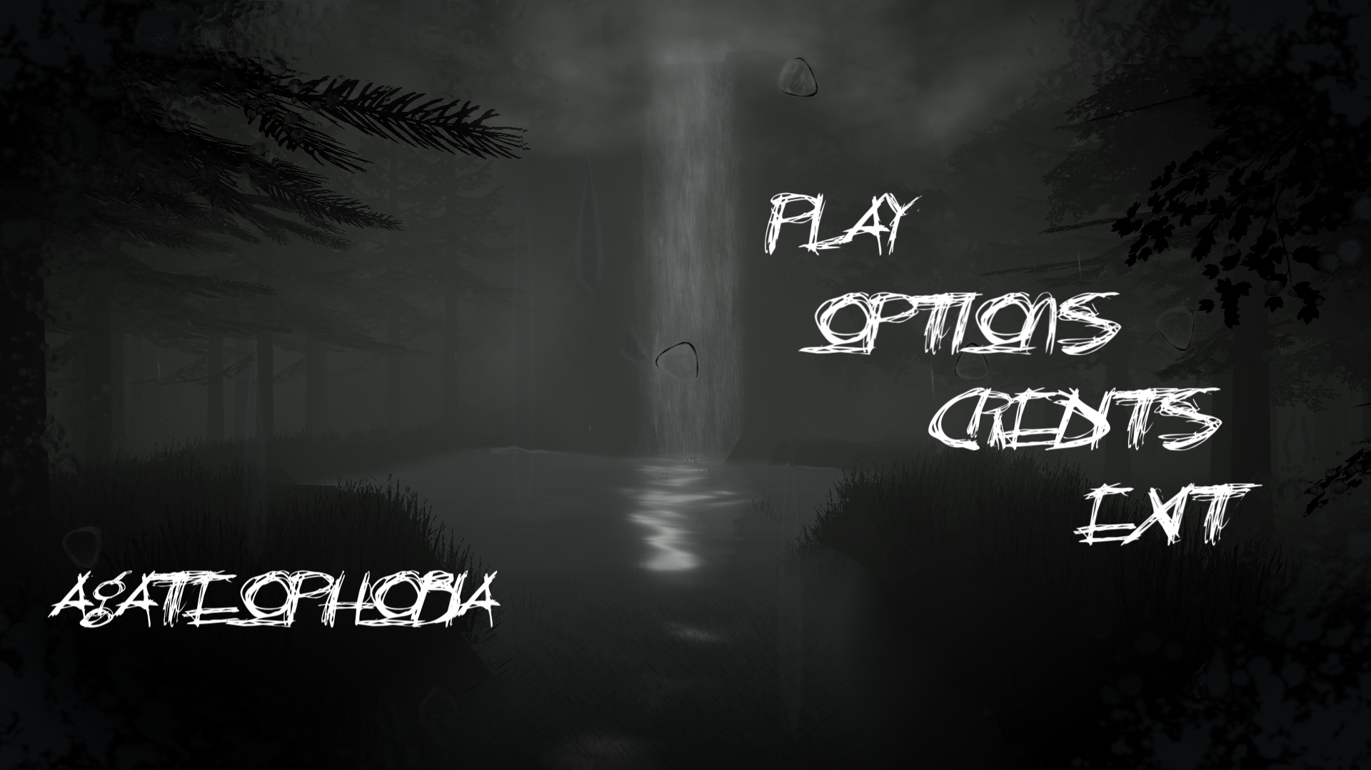
MAIN MENU

Slide 7
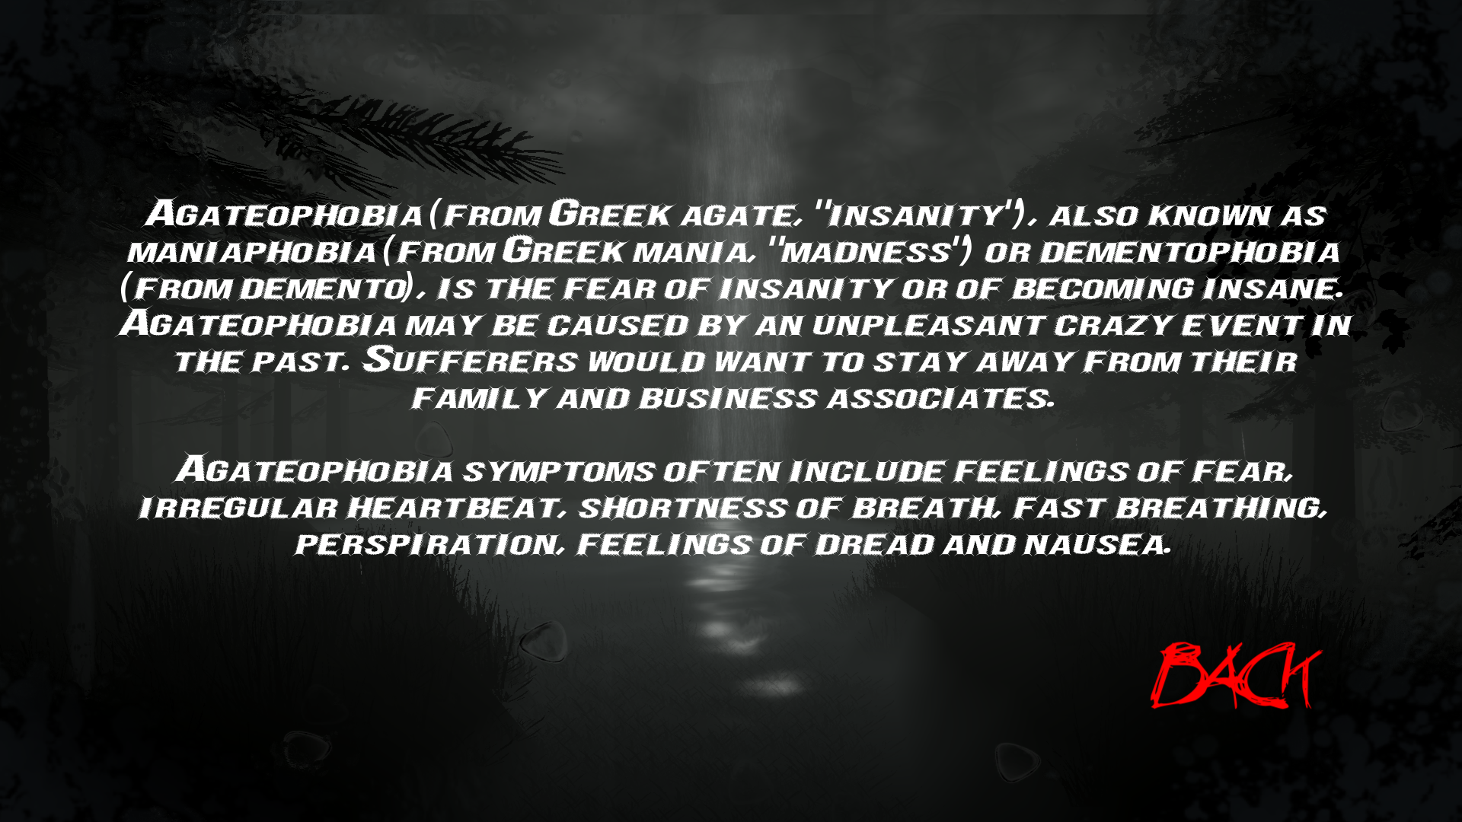
AGATEOPHOBIA (SUB-MENU)

Slide 8
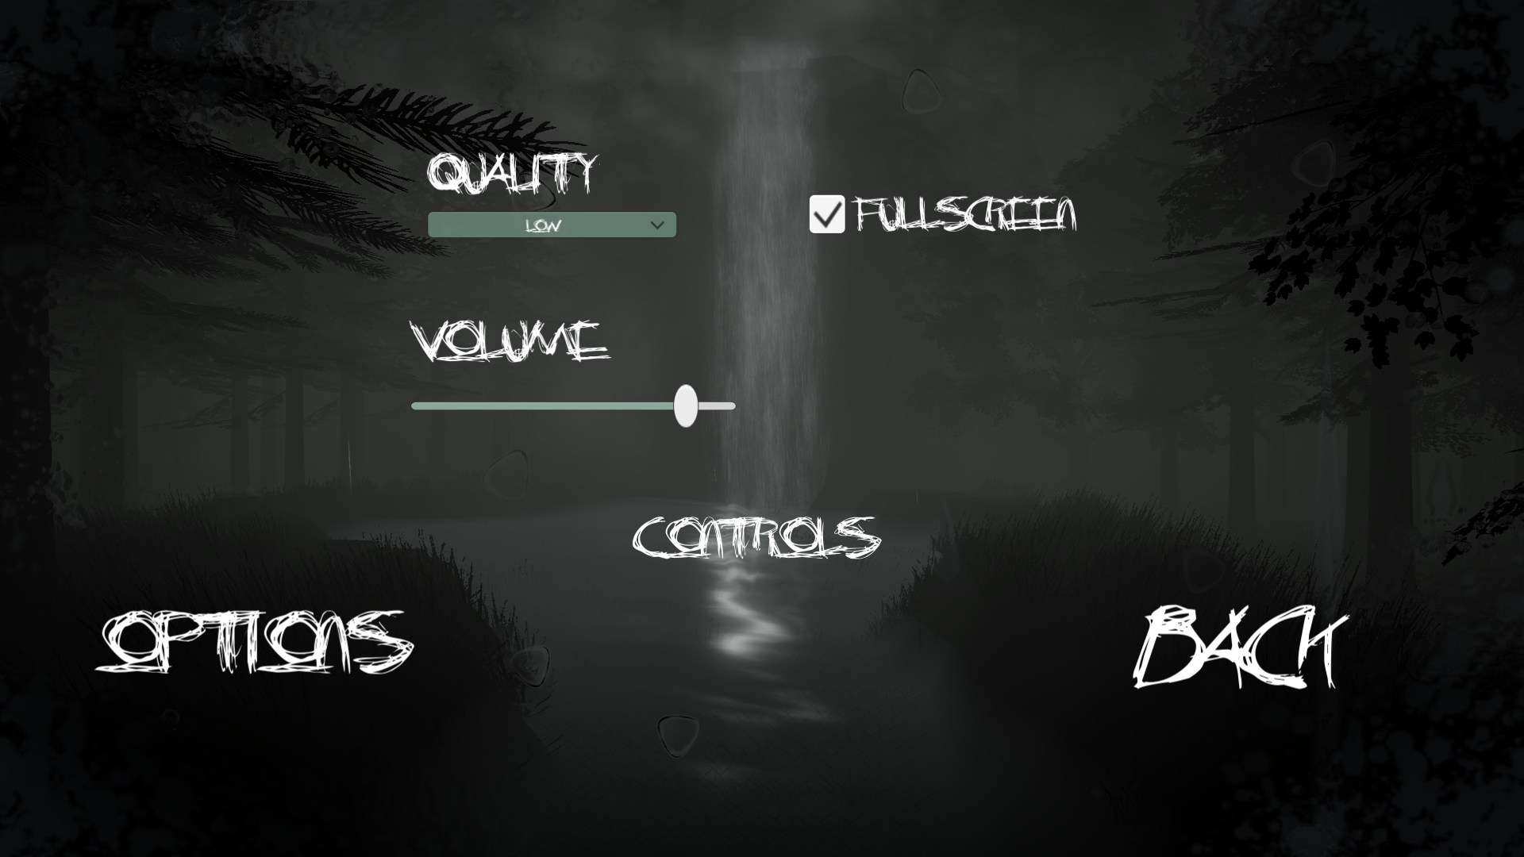
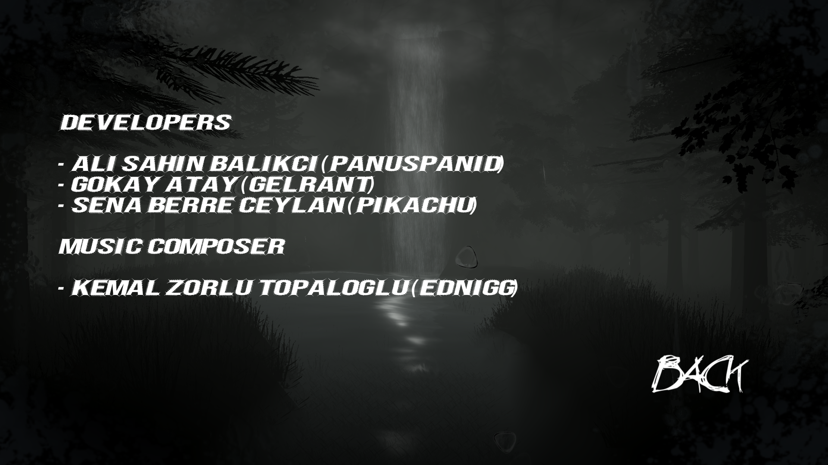
OPTIONS & CREDITS (SUB-MENU)
OPTIONS
CREDITS

Slide 9
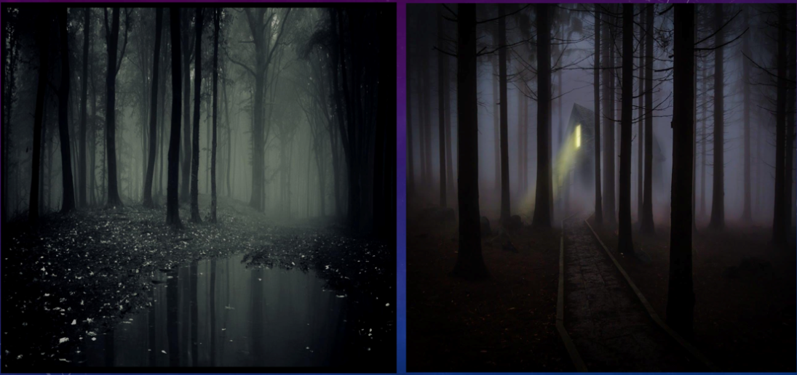
LEVEL 1 – HAUNTED FOREST (SUMMARY OF #P1)
We mentioned before, on the project proposal, how the haunted forest scene would look like.

Slide 10
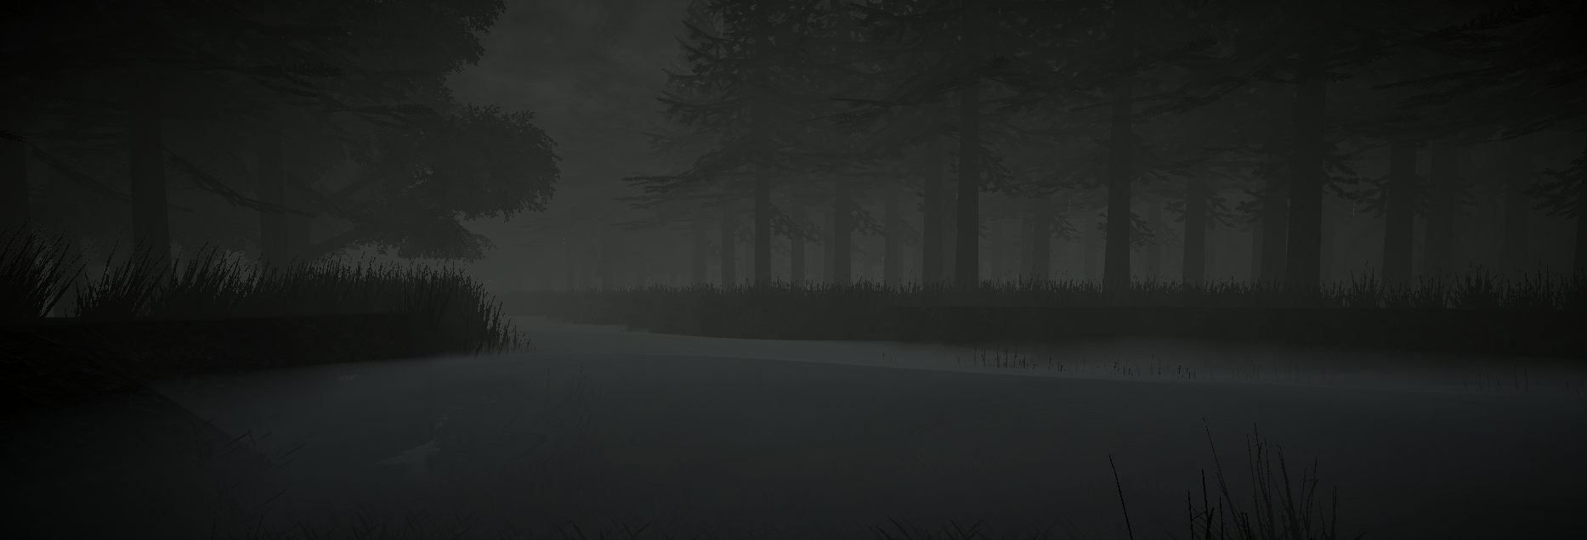
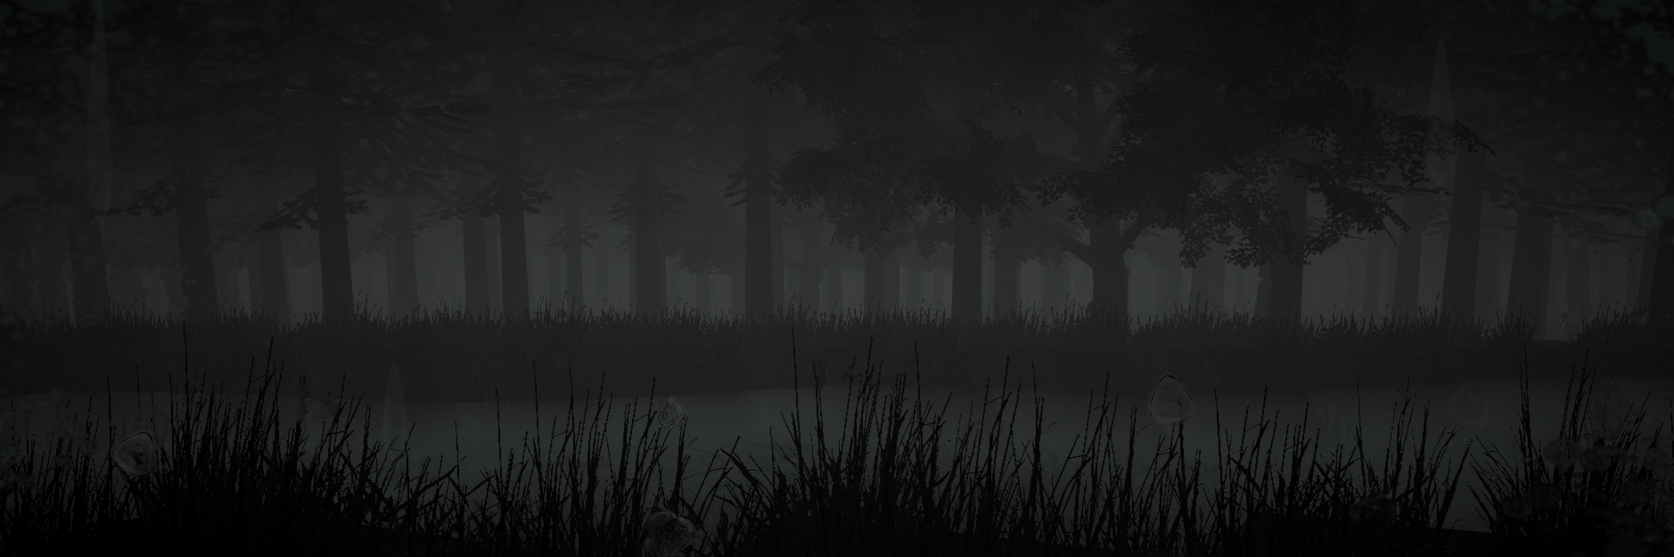
General View of the Forest

Slide 11
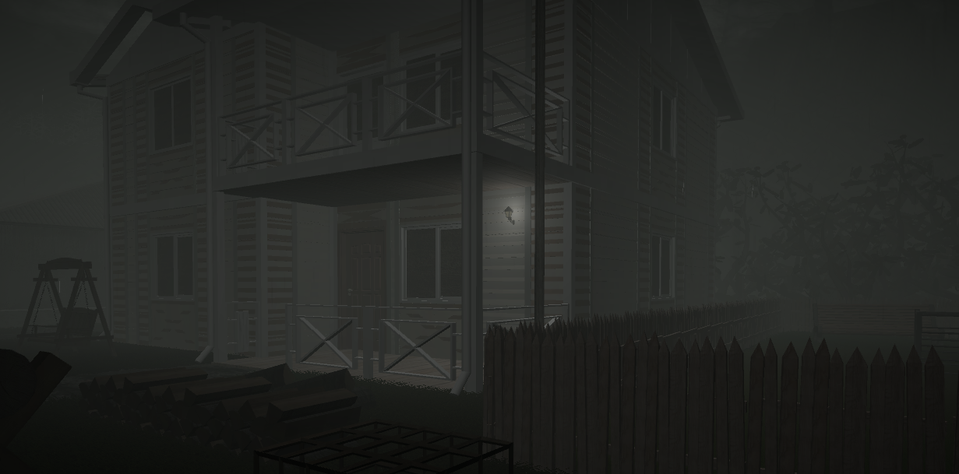
View of the Main Character's House

Slide 12
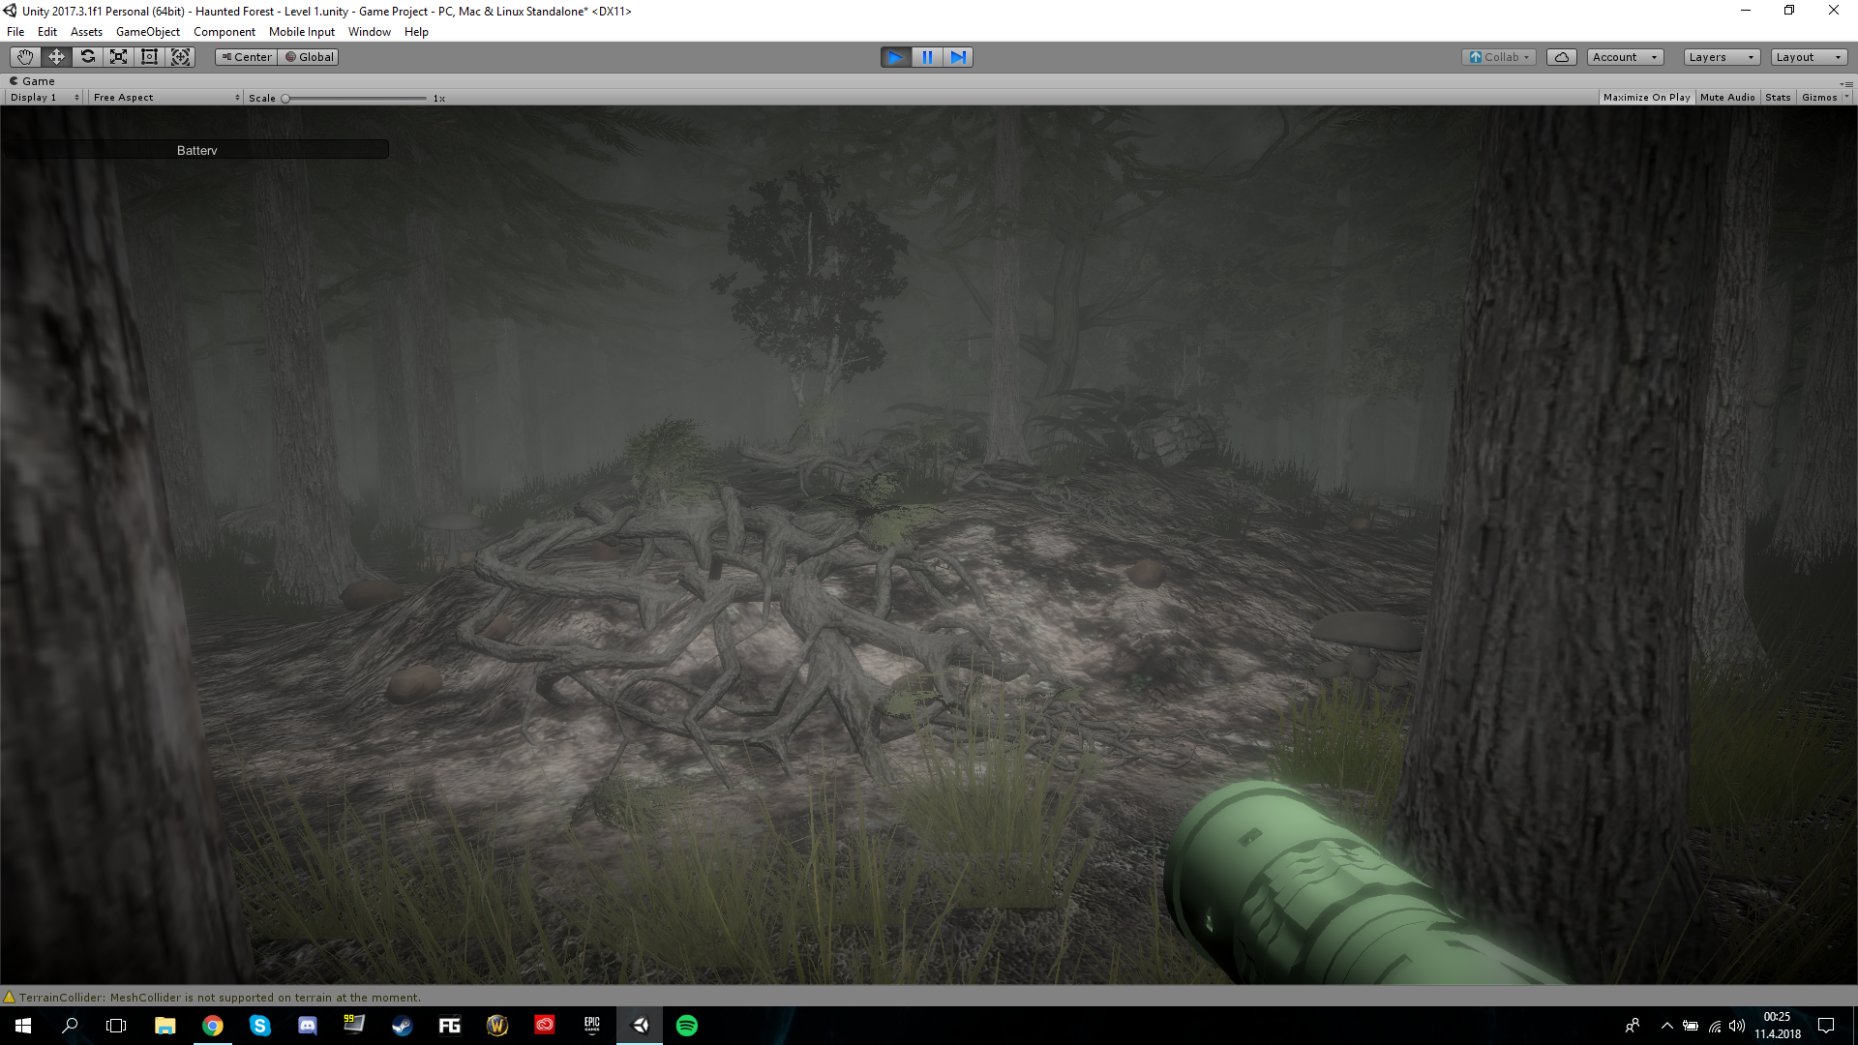
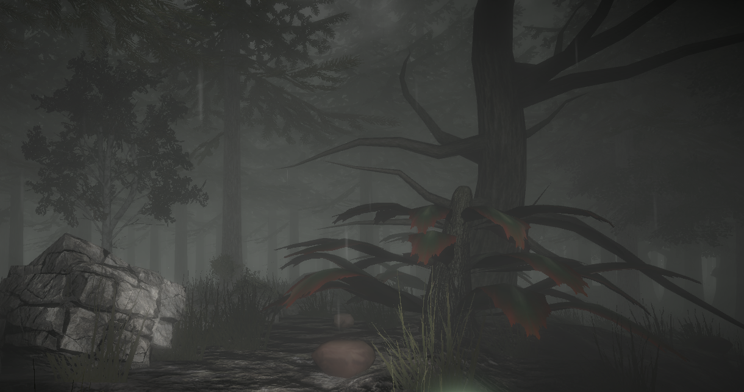
Different assets such as roots, trees/plants, stones/boulders and mushrooms are placed on the scene. We've created a foggy environment to reflect a frightening forest.

Slide 13
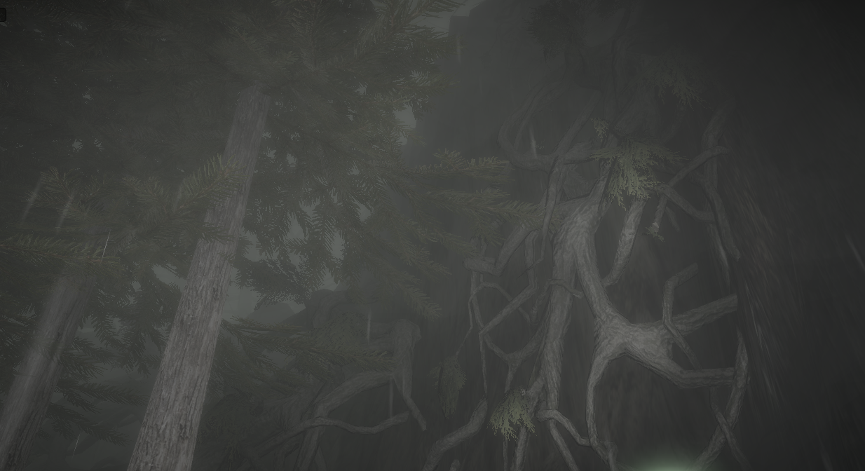
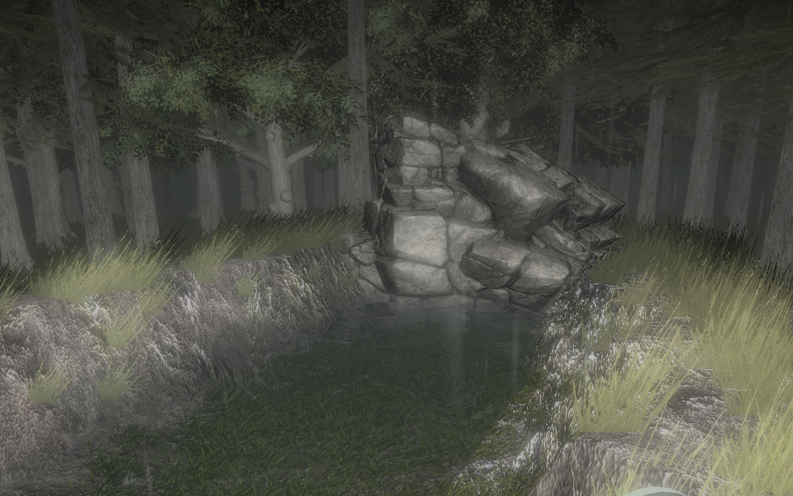

Slide 14
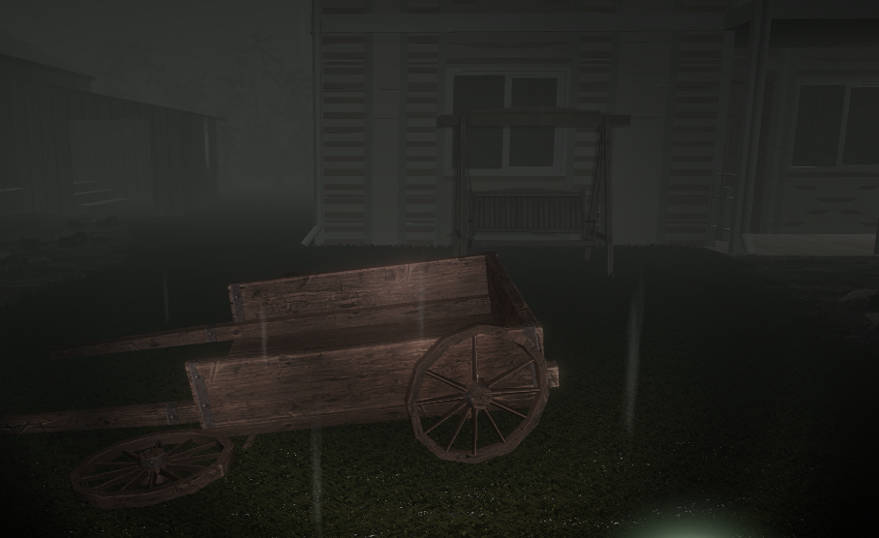
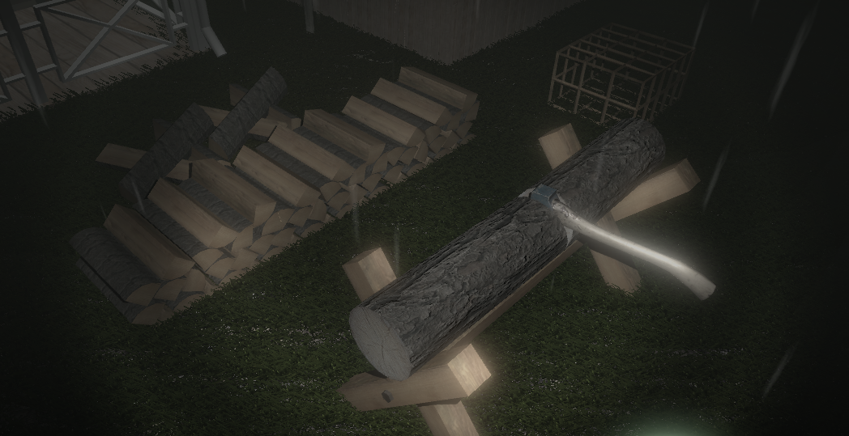
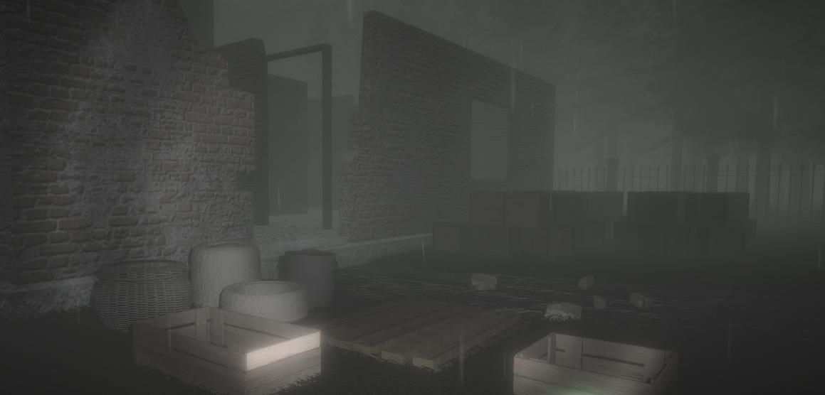
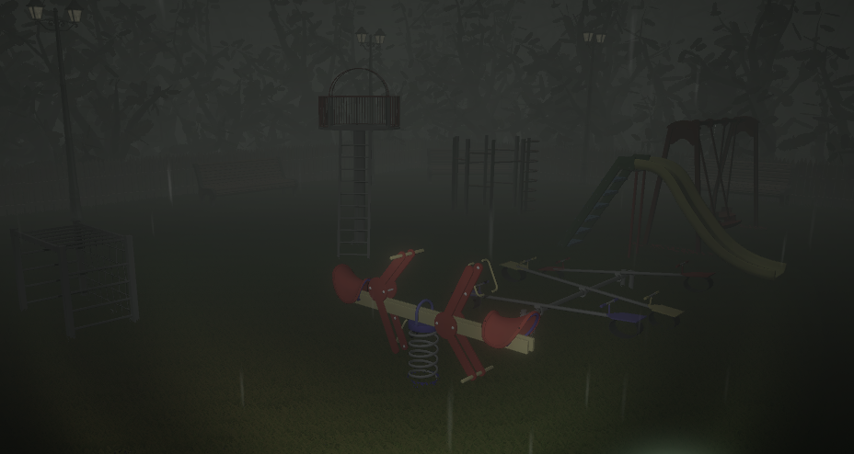

Slide 15
LEVEL 1 – HAUNTED FOREST (#P2)

Slide 16
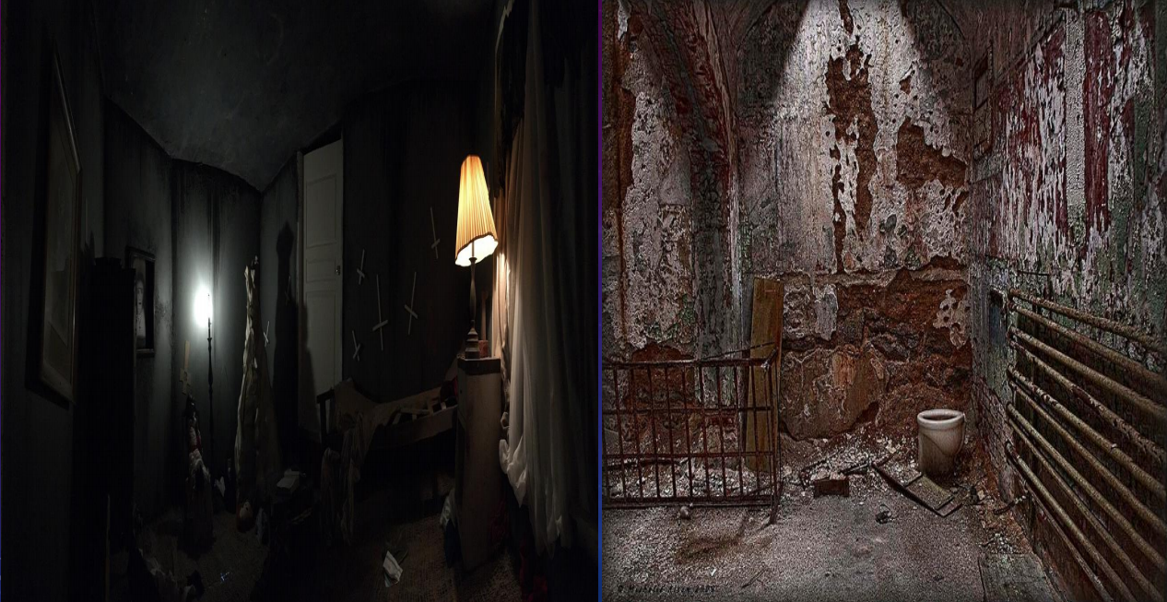
LEVEL 2 – BURNT HOUSE
Proposal images of the level

Slide 17
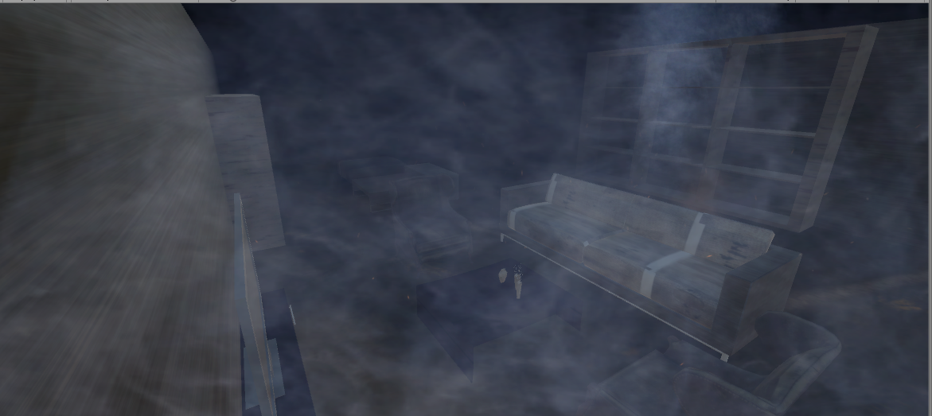
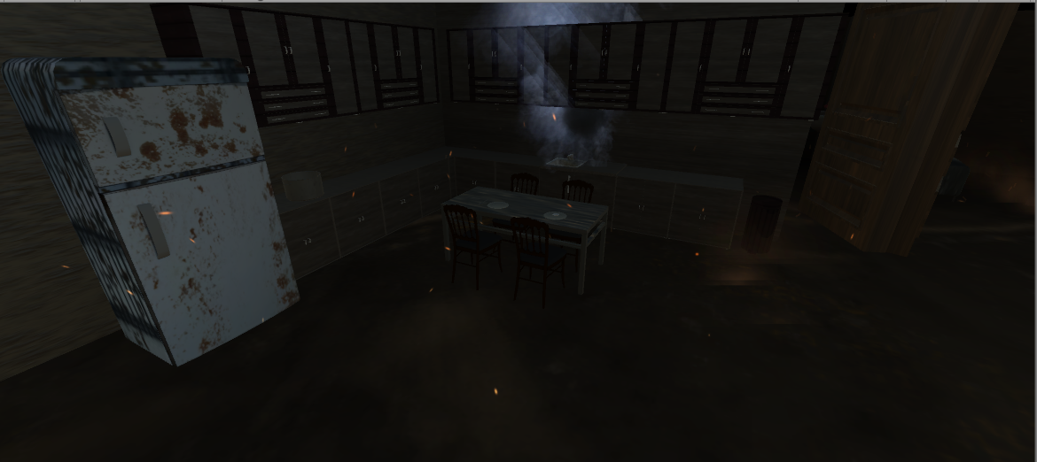
General vıews of the level

Slide 18
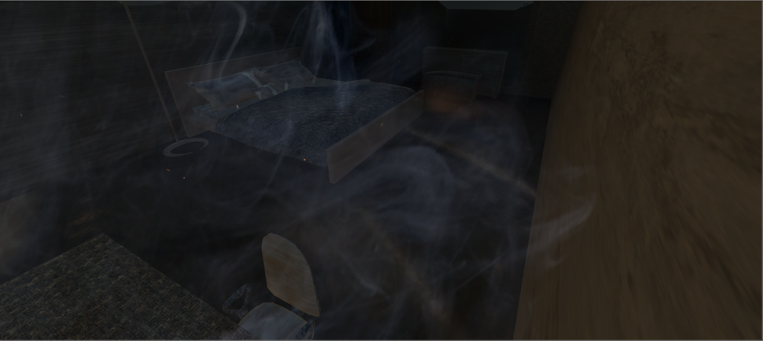
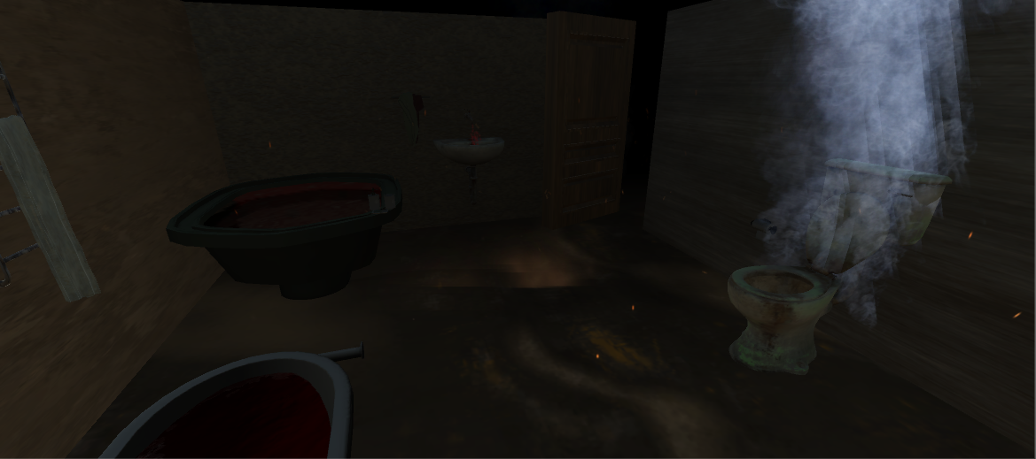
GENERAL VIEWS OF THE LEVEL

Slide 19
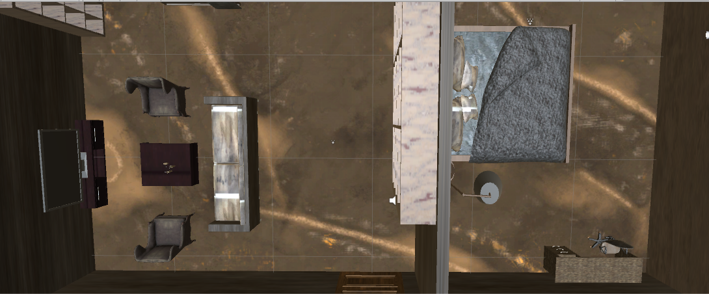
General ArchItecture of the house
House have one bedroom, one kitchen/living room and one bathroom in ground floor. Other floor's of the house were burnt and unreachable in the game.

Slide 20
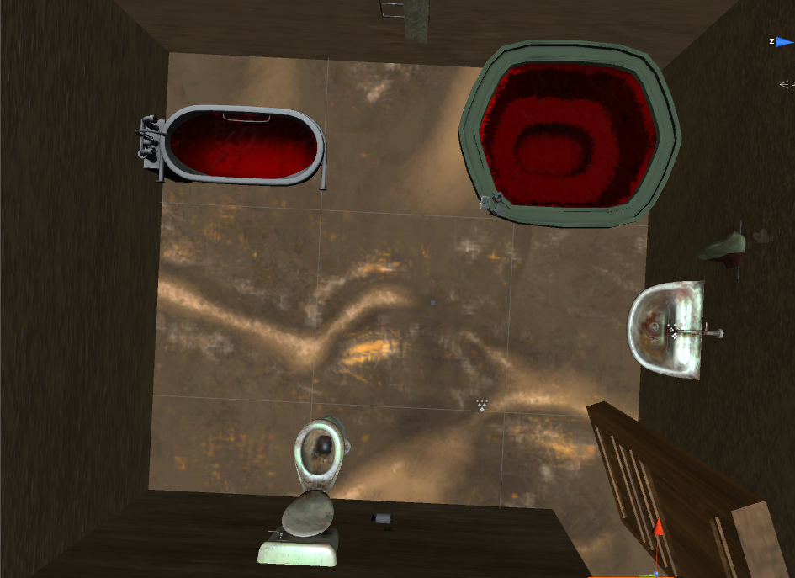
Bathroom
Bathroom includes a lot of assets. Bathtub, toilet, towels, washbasin, taps are some of them. Also bathroom has unique enviromental sound. When player enters to bathroom, the sound opens.

Slide 21
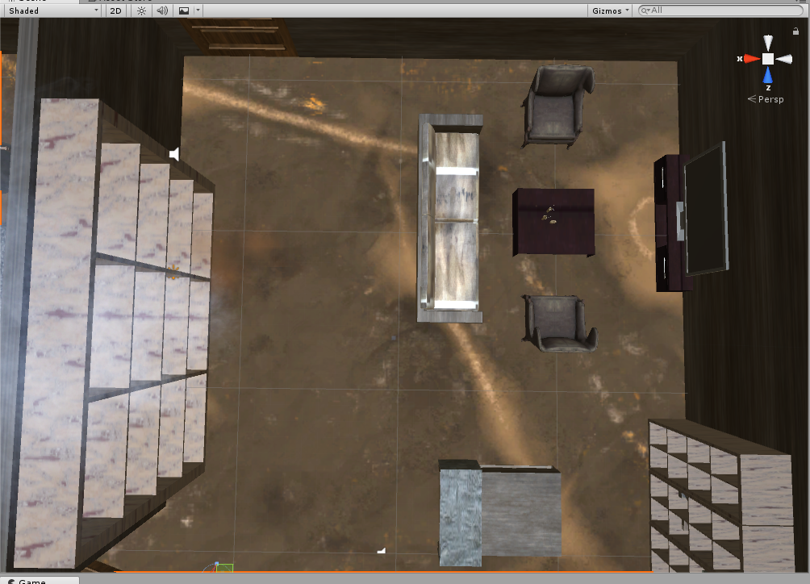
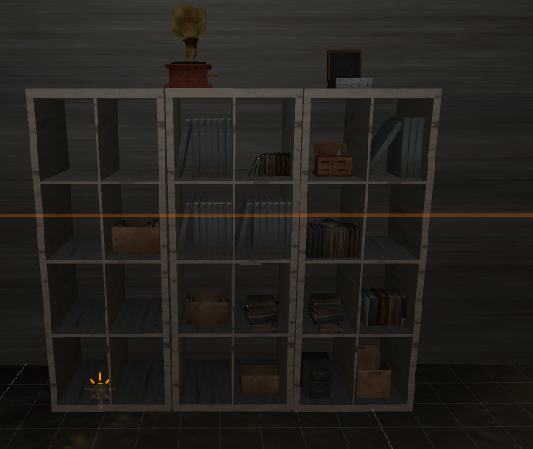
LIVING ROOM
Living room includes a lot of assets. Chairs, TV, coffee table, bookcase, vases, TV unit are some of the assets. There are some spotlights in the living room. These lights are inactive form they will be organized later of the project.

Slide 22
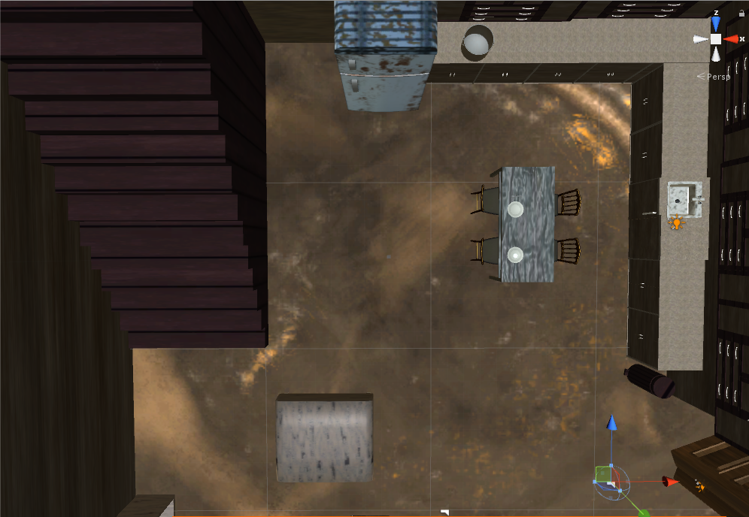
KıTcHEN
Kitchen includes a lot of assets. Sink, cabinets, tap, plates, chairs, pot, fridge, puff armchair, dump are some of the assets. In the architecture, stairs placed near the kitchen.

Slide 23
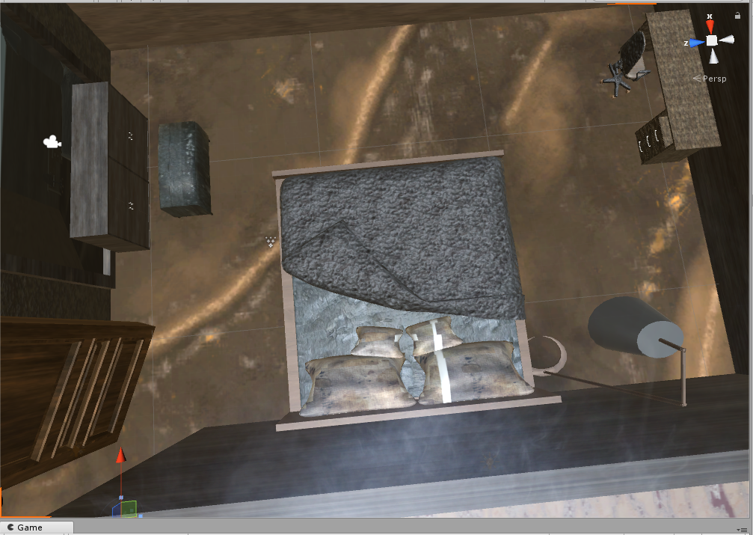
Bedroom
Bedroom includes a lot of assets. Lamp, bed, cabinets, mirror, study desk, chair are some them. A spotlight and collider system including in the bedroom. When player walked in the room flickering lamp will be active with sound effect.

Slide 24
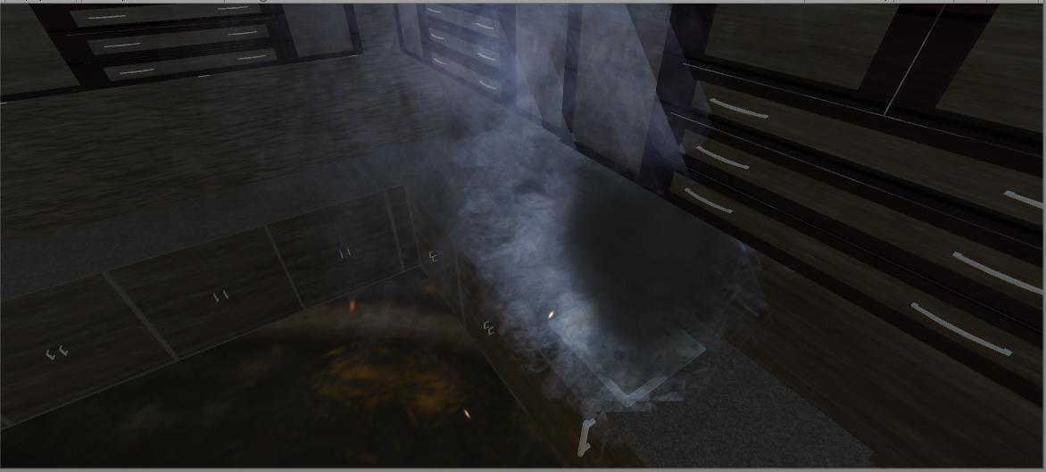
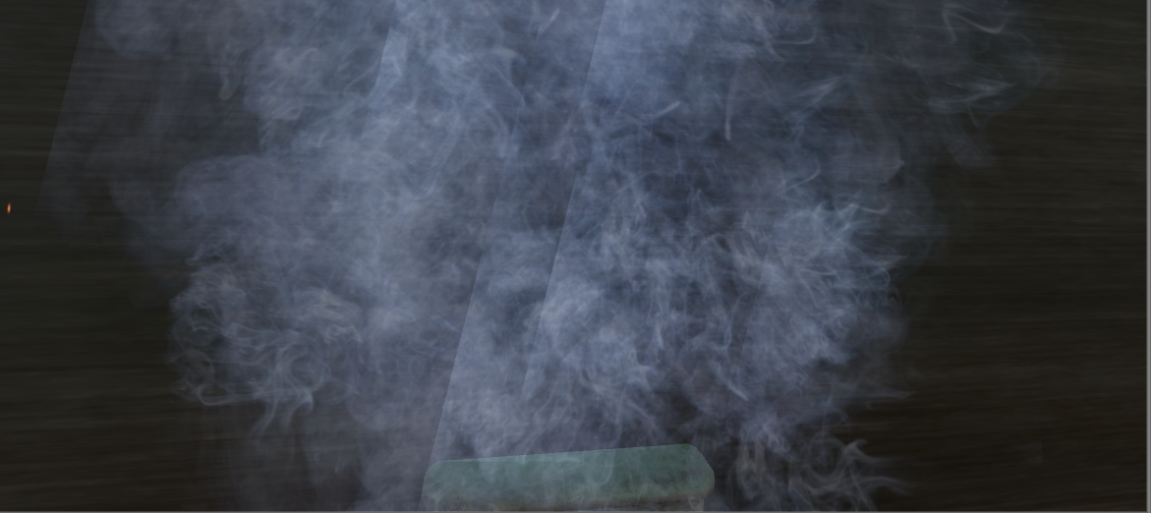
Partıcle Systems
In the house many particle systems are used. They are white and black smoke particle systems, ember particle system, blood splash particle system, flame particle system and dust particle system. These systems can be increase in the future while developing.

Slide 25
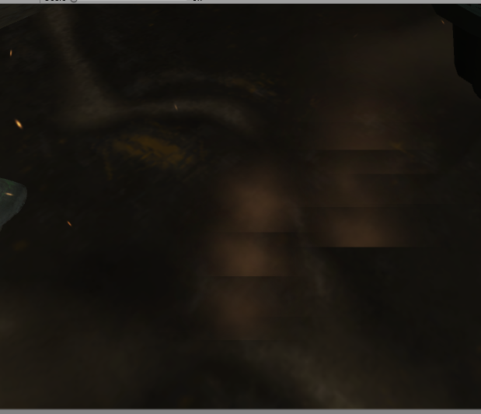
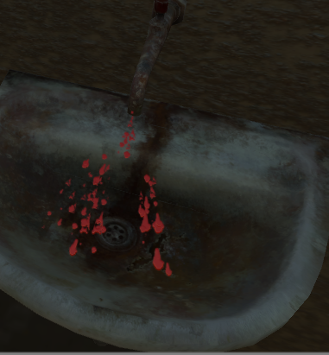
Partıcle systems

Slide 26
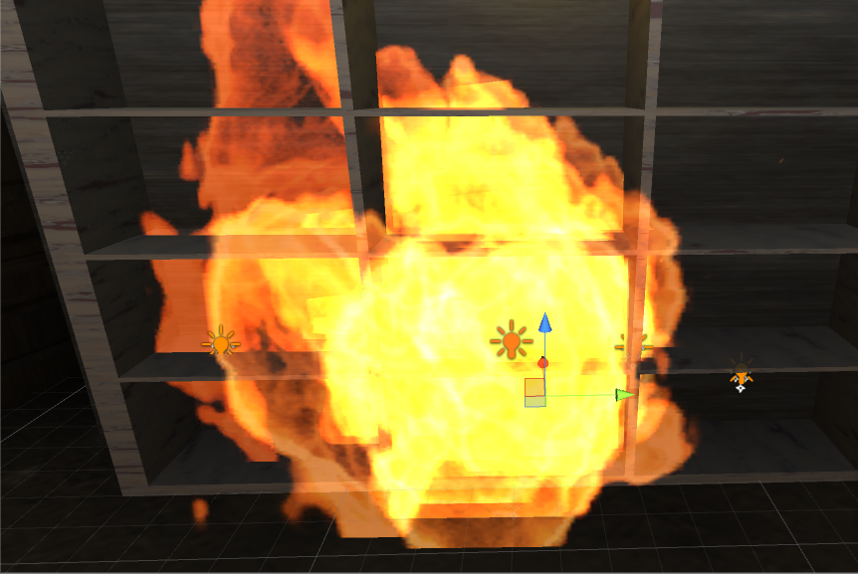
PARTICLE SYSTEms

Slide 27
Sound Effects/MUsıc
House has three background music. They are girl playing song, fire sound and wind blowing sound. Electirical sizzle sound is in level but inactive form. It will be adding with spotlights.

Slide 28
LEVEL 3 - HOSPITAL

Slide 31
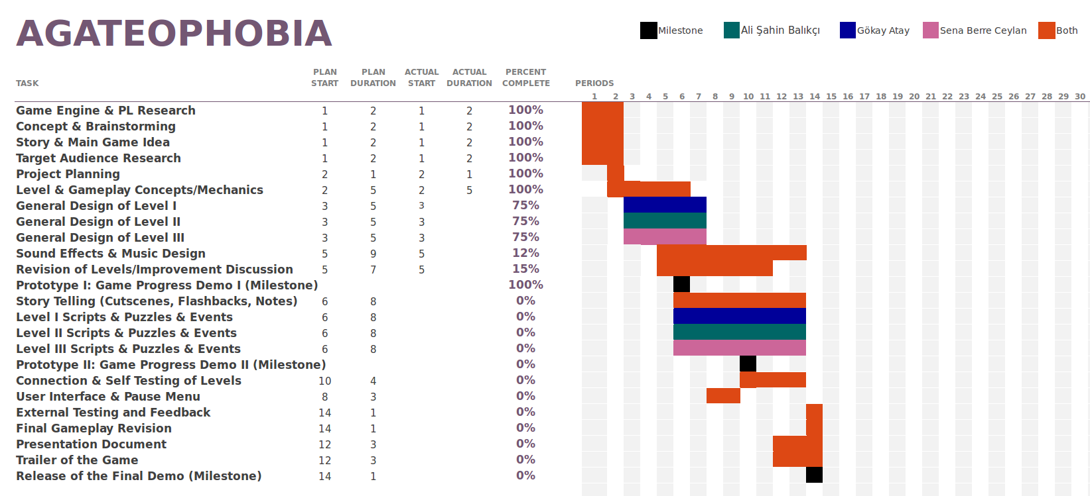
PROJECT PLAN – GANTT CHART

